Slide 1
AWS CodeDeploy, AWS CodePipeline, and AWS CodeCommit: Transforming Software Development
Andy Troutman
Manager, AWS Deployment Services
©2015, Amazon Web Services, Inc. or its affiliates. All rights reserved.

Slide 2
Agenda
The Amazon DevOps story
New developer tools
AWS CodeDeploy
AWS CodePipeline
AWS CodeCommit
Summary/Q&A
Notes:
Agenda
In this talk, I'm going to walk you through some the changes that Amazon has made over the years, and tell you about the developer tools we built to support those architectural and organizational changes.
- the Amazon DevOps Story
- CodeDeploy
- CodePipeline
- CodeCommit
Do we have a What's Next section, or just a Summary?

Slide 3
The Amazon DevOps story
©2015, Amazon Web Services, Inc. or its affiliates. All rights reserved

Slide 4
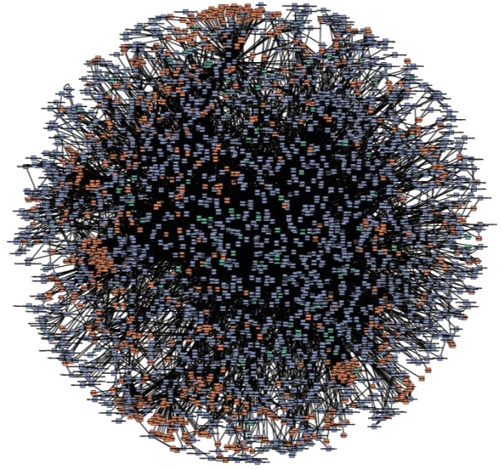
Service-Oriented Architecture (SOA)
Everything gets a service interface
Primitives
“Microservices”
Notes:
Moving to a SOA
- everything gets a service interface
- breaking monolithic app into small services (primitives)
- picture of what amazon.com looked like after this transformation (actual depiction of our service architecture)
- today, I guess it’s popular to call this “microservices”

Slide 5

Decentralized
Two-pizza teams
Agility, autonomy, accountability, and ownership
“DevOps”
Notes:
Moving to agile (organizational change to two pizza teams)
- speed & agility
- ownership
- automony & accountability
- today, I guess it’s popular to call this “devops”

Slide 6

Notes:
Needed new tools requirements:
- decentralized ownership (self-service)
- promote best practices without being restrictive (guardrails)
- technology agnostic
- support agile SDLC

Slide 7

Deployment service
Zero downtime
Health checking
Versioned artifacts & rollbacks
Notes:
Apollo
- dozen years ago
Deploy without downtime
Health checking
Centralized dashboard

Slide 8

Continuous delivery
From check-in to production
CI/CD + release automation
>90% of teams
Pipelines
Notes:
- Pipelines is our internal continuous deployment tool
About 6-7 years ago, we looked at how long it was taking teams inside of amazon to go from source code checkin to have the code running in production, and we discovered that it took an embarrassing long time (several weeks).
What we discovered was that it wasn’t that the tools were taking that long. It was all the manual human processes in between (approval, feedback, notifications). We were wasting a lot of time because humans were advancing software through the different phases of the development process (source, build, test, deploy).
so we built “pipelines” (and this is before the industry even had a term for it).
we built in all the traditional aspects of CI/CD (internal build and test), but we extended that to also include what is sometimes referred to as “release automation” (defining the different stages of your application – alpha, beta, gamma, prod -- and orchestrating the release of software through that – and even beyond that – to different AZs and different regions. What is now called “continuous deployment”
- Today, most teams at amazon use pipelines (>90% of teams)

Slide 9
Thousands of teams +
Microservices architecture +
Multiple environments +
Continuous delivery
= 50 million deployments a year
Notes:
So, what happens when you have thousands of development teams… each running a microservices or SOA architecture… each with multiple environments (alpha, beta, gamma, prod… something multiple regions)… each doing continuous deployments?
You get *a lot* of deployments.
Last year, Apollo handles 50 million deployments – that’s 1.5 deployments per second!

Slide 10


Notes:
But AWS customers want the same tooling to release as frequently and reliably as Amazon
- the new Code services will enable customers to do just that
- we'll walk through how you can use these tools to wire together your own DevOps pipeline

Slide 11

DevOps Pipeline
Source Developers commit changes
Build Changes are built and unit tested
Staging Code deployed to staging and load/UI tested
Production Code is deployed to production
Developers
Customers
Changes, updates, and fixes
Ideas, requests, and bugs

Slide 12
AWS CodeDeploy
©2015, Amazon Web Services, Inc. or its affiliates. All rights reserved
Notes:
- we'll start with AWS CodeDeploy

Slide 13

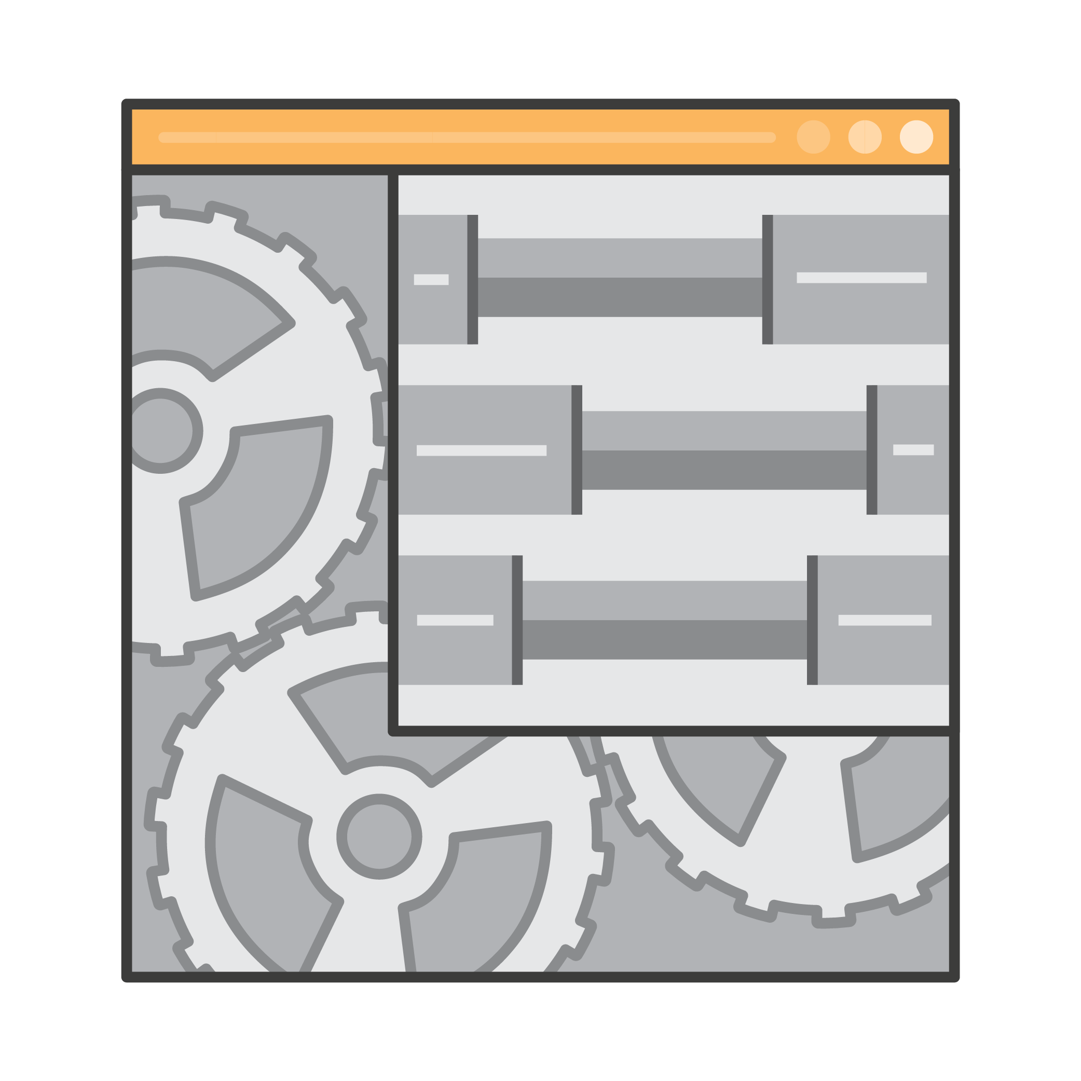

Why use a deployment service?
Automate
deployments
Manage
complexity
Avoid
downtime
Notes:
- first we ask ourselves "why do we need a deployment service"
- automated deployments are a fundamental requirement for any effective DevOps pipeline
- must be able to quickly and reliably deploy your code to multiple environments (dev, test, staging, production)
- you'll be doing this very often, so you don't want any friction as you iterate
- any manual steps will slow you down and introduce errors
- if you just have one developer deploying code to one server, you can accomplish this with SSH and some scripts
- but as you add developers or expand your server fleet, the complexity of coordinating deployments grows quickly
- what happens if 1 instance deployment fails in a 10 instance deployment? what if multiple developers try to deploy different updates at the same time? how do you deploy to a production fleet without any downtime?
- a deployment service can help orchestrate all of this for you and let you concentrate on writing new features for your application

Slide 14

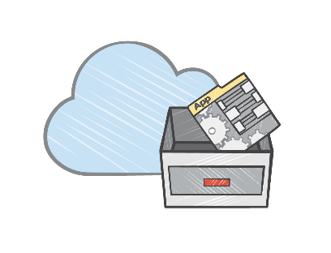

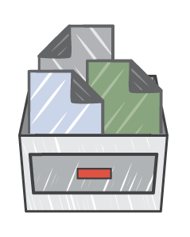
CodeDeploy
Coordinate automated deployments, just like Amazon
Application
revisions
Deployment groups
Dev
CodeDeploy
v1, v2, v3
Staging
Production
Scale from 1 instance to thousands
Deploy without downtime
Centralize deployment control and monitoring
Notes:
- CodeDeploy enables you to deploy code to your servers just like Amazon does
- it was inspired by our internal Apollo service and leverages all of the learning from over a decade of deployments
- you just define how you want your application installed on a single instance, and CodeDeploy can handle scaling a deployment across thousands of instances
- it will let you configure the speed of a roll out so you can balance availability and deployment duration
- and it enables you to deploy to a running fleet without application downtime
- CodeDeploy can become the central tool that you use to control and monitor which application versions are deployed to your different runtime environments
let's take a look at how you do these things in CodeDeploy
- On-Premises support!

Slide 15
Step 1: Package your application (with an AppSpec file)
version: 0.0
os: linux
files:
- source: chef/
destination: /etc/chef/codedeploy
- source: target/hello.war
destination: /var/lib/tomcat6/webapps
hooks:
ApplicationStop:
- location: deploy_hooks/stop-tomcat.sh
BeforeInstall:
- location: deploy_hooks/install-chef.sh
AfterInstall:
- location: deploy_hooks/librarian-install.sh
ApplicationStart:
- location: deploy_hooks/chef-solo.sh
ValidateService:
- location: deploy_hooks/verify_service.sh
Notes:
- the first step is to package your application up for deployment
- you need to define how to install your application on a single instance, and you use an AppSpec file to do that
- this file is what provides the extreme flexibility that enables CodeDeploy to work with virtually any type of application
- you specify where you'd like files copied, and what scripts you want to execute during the deployment lifecycle
- you have complete control and can call whatever scripts or tools you want
- this approach comes out of our experience with Apollo, where we learned that giving control to developers enables adoption for the broadest set of use cases
- in this example, we call out to a Bash script to install application dependencies
- in that script we use community-authored Chef cookbooks to install XXX
- the appspec also calls a test script written in JavaScript
- we can mix and match whatever tools and languages we like

Slide 16
Step 1: Package your application (with an AppSpec file)
version: 0.0
os: linux
files:
- source: chef/
destination: /etc/chef/codedeploy
- source: target/hello.war
destination: /var/lib/tomcat6/webapps
hooks:
ApplicationStop:
- location: deploy_hooks/stop-tomcat.sh
BeforeInstall:
- location: deploy_hooks/install-chef.sh
AfterInstall:
- location: deploy_hooks/librarian-install.sh
ApplicationStart:
- location: deploy_hooks/chef-solo.sh
ValidateService:
- location: deploy_hooks/verify_service.sh
Notes:
To get the cookbooks and app files into the right locations, we configure the files section of the appspec like so. All of our chef-specific files end up in /etc/chef/codedeploy and the compiled java archive ends up in the Tomcat webapp directory.

Slide 17
Step 1: Package your application (with an AppSpec file)
version: 0.0
os: linux
files:
- source: chef/
destination: /etc/chef/codedeploy
- source: target/hello.war
destination: /var/lib/tomcat6/webapps
hooks:
ApplicationStop:
- location: deploy_hooks/stop-tomcat.sh
BeforeInstall:
- location: deploy_hooks/install-chef.sh
AfterInstall:
- location: deploy_hooks/librarian-install.sh
ApplicationStart:
- location: deploy_hooks/chef-solo.sh
ValidateService:
- location: deploy_hooks/verify_service.sh
Notes:
- First, we’ll want to check whether or not Tomcat is running. If this is our first deployment, nothing will happen here, but subsequent deployments will stop the daemon.
- Then, we check that chef, knife, and other related tools are actually installed and accessible. We do this in the “BeforeInstall” step -- that is, after the application revision has been downloaded -- so that we’re running with the most recent version of the hook script.
- After all our files are in the right locations, we’ll execute “knife install” to pull the tomcat cookbook from the supermarket. Alternatively, you could run this on your dev box and just push the tomcat cookbook in the application revision.
- Since the cookbook starts the tomcat daemon, we put off running chef-solo until the ApplicationStart event.
- And finally, we do a simple curl or wget to check that it’s responding reasonably.

Slide 18
Step 2: Set up your target environments
Deployment group
Deployment group
Agent
Agent
Agent
Agent
Agent
Agent
Staging
Group instances by:
Auto Scaling group
Amazon EC2 tag
On-premises tag
Agent
Agent
Agent
Production
Notes:
- next we prepare our deployment targets
- we need to install the CodeDeploy agent on each server
- then we group the target server fleets for your application by using EC2 tags, on-premises tags, or Auto Scaling Group
- you can choose to divide your target groups however you'd like
- you can split between your development, testing, staging, and production environments
- you can tag all servers that run Tomcat aNeed pplications if you want to be able to patch the Tomcat runtimes separate from your applications

Slide 19
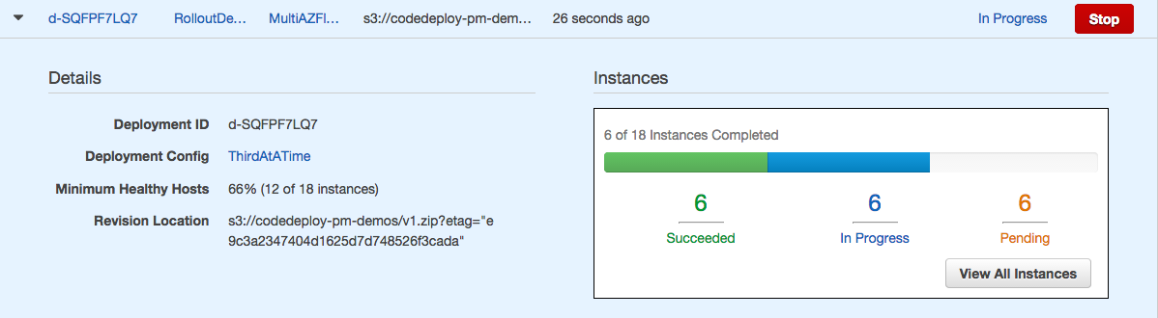
Step 3: Deploy!
AWS CLI & SDKs
AWS Console
CI / CD Partners
GitHub
aws deploy create-deployment \
--application-name MyApp \
--deployment-group-name TargetGroup \
--s3-location bucket=MyBucket,key=MyApp.zip
Notes:
- use the CLI, an SDK, the Console, or one of our partner integrations like Jenkins, Travis CI, and GitHub to kick off a deployment

Slide 20
Deployment config – Choose speed
One at a time
v2
v1
v1
v1
v1
v1
v1
v1
Half at a time
v2
v2
v2
v2
v1
v1
v1
v1
All at once
v2
v2
v2
v2
v2
v2
v2
v2
Notes:
- CodeDeploy offers a number of features that help you orchestrate how a deployment rolls out across your fleet

Slide 21
Rolling update – Deploy without downtime
Load Balancer
v1
v1
v1
Notes:
One major benefit of CodeDeploy is that it can update an active fleet without requiring any application downtime. That’s done by choosing a deployment configuration that will ensure the fleet remains available during a deployment. Here’s an example of that. We have 3 hosts running behind a load balancer and we set the minimum healthy hosts for the deployment to 2.

Slide 22
Rolling update – Deploy without downtime
Load Balancer
v2
v1
v1
Notes:
CodeDeploy only takes one instance offline at a time to perform an update, and then returns it to the load balancer before progressing to the next instance.

Slide 23
Rolling update – Deploy without downtime
Load Balancer
v2
v2
v1
Notes:
It then continues this process across the rest of the fleet.

Slide 24
Rolling update – Deploy without downtime
Load Balancer
v2
v2
v2

Slide 25
Rolling update – Deploy without downtime
Load Balancer
v2
v2
v2
Notes:
By doing this, we always have at least two hosts receiving traffic and the application stays available.

Slide 26
Health Tracking – Catch deployment problems
Load Balancer
v2
v2
v2
Notes:
By doing this, we always have at least two hosts receiving traffic and the application stays available.

Slide 27
Health tracking – Catch deployment problems
Load Balancer
v3
v2
v2
Stop
Notes:
Sometimes, a developer might deploy a bad change that fails during deployment. Hopefully they have the right test process in place to catch this before a production deployment, but sometimes it does happen. If it does, CodeDeploy will stop the roll out because it cannot take any more instances offline without violating the minimum healthy hosts. At this point, the developer could rollback by re-deploying the prior version, or they could make a quick fix and deploy a newer version.

Slide 28
Health tracking – Catch deployment problems
Load Balancer
Rollback
v2
v2
v2
Notes:
On the next update, CodeDeploy knows to start by updating the unhealthy host first since it’s already offline. After that, it progresses through the remainder of the fleet, bringing them all up to the new version.

Slide 29
Health tracking – Catch deployment problems
Load Balancer
v2
v2
v2

Slide 30

Demo
Notes:
[GitHub to make change and trigger deployment]
[ELB deployment visualization or multi-AZ demo]
[Console to review status and inspect past failure]

Slide 31







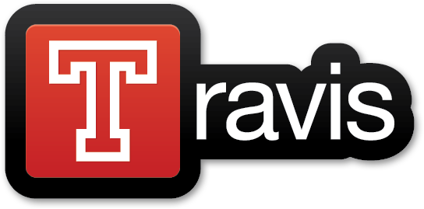
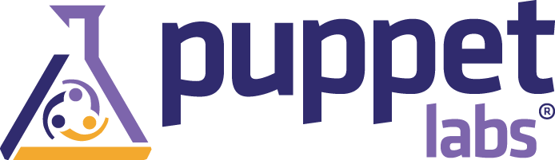
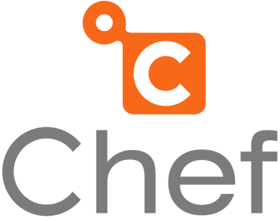




Product integrations

Slide 32
AWS CodePipeline
©2015, Amazon Web Services, Inc. or its affiliates. All rights reserved
Notes:
- let's now take a look at AWS CodePipeline

Slide 33


Why use a release automation service?
Automate
workflow
Release
quickly
Ensure
quality
Notes:
- after automating your deployments, you'll want to automate your full end-to-end release workflow
- this includes taking a source code change, building it, testing it, and putting it through your required quality checks before deploying it into production
- why would you want to automate that process, instead of just handling it manually?
- it's slow – you want to remove any lag between the stages
- it's inconsistent – you want to eliminate any mistakes or shortcuts in the qualification process

Slide 34
CodePipeline
Continuous delivery and release automation, just like Amazon
Source
Build
Beta
Gamma
Production
1) Build
2) Unit test
1) Deploy
2) UI test
1) Deploy
2) Load test
1) Deploy region1
2) Deploy region2
3) Deploy region3
Customizable workflow engine
Integrate with partner and custom systems
Visual editor and status
Notes:
- CodePipeline enables you to automate your release process just like Amazon does
- it was inspired by our internal Pipelines service
- you define you're custom release workflow, stringing together all of the actions and checks that you want to perform
- the pipeline actions are extensible, and partners and customers can plug in their own custom source, build, test, and deployment systems
- once set up, CodePipeline will run code changes through your release process and give you a visual status of how those changes are progressing through your pipeline
- let's see how you set up CodePipeline

Slide 35

Demo

Slide 36
AWS CodeCommit
©2015, Amazon Web Services, Inc. or its affiliates. All rights reserved
Notes:
- now that we've covered how to automate release pipelines, let's talk about the source control system that's at the front of the whole process
- the last service that we'll talk about is AWS CodeCommit

Slide 37
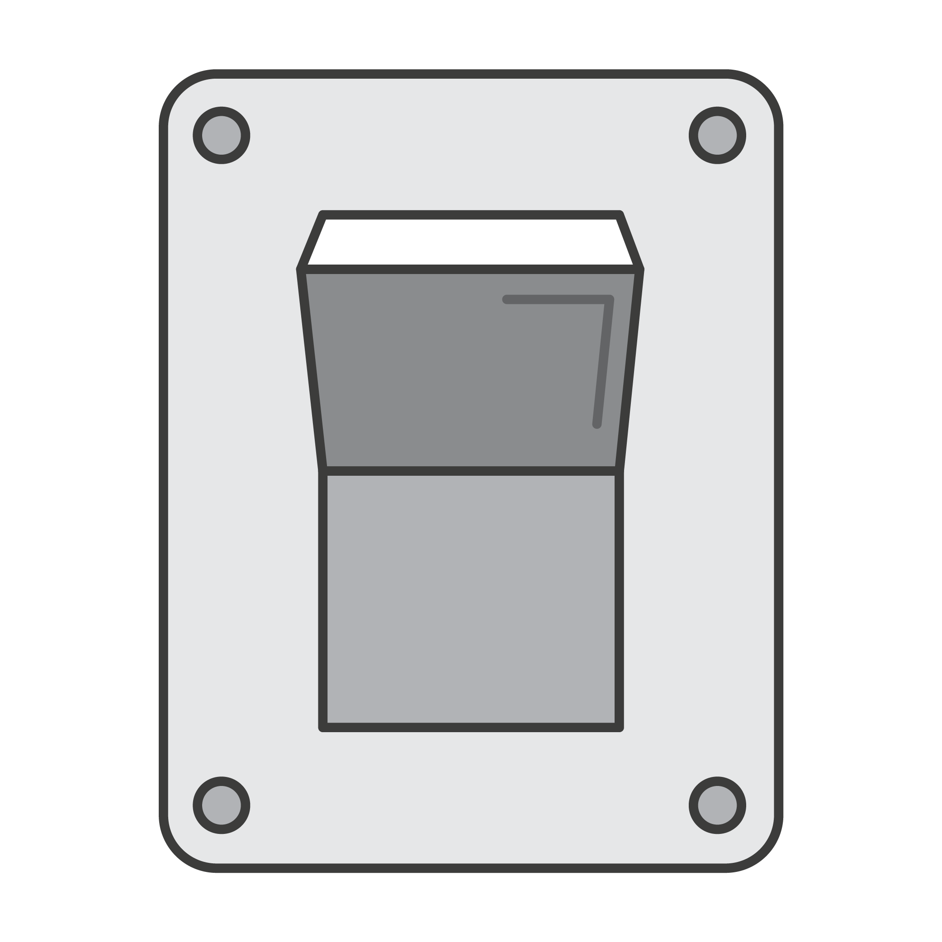
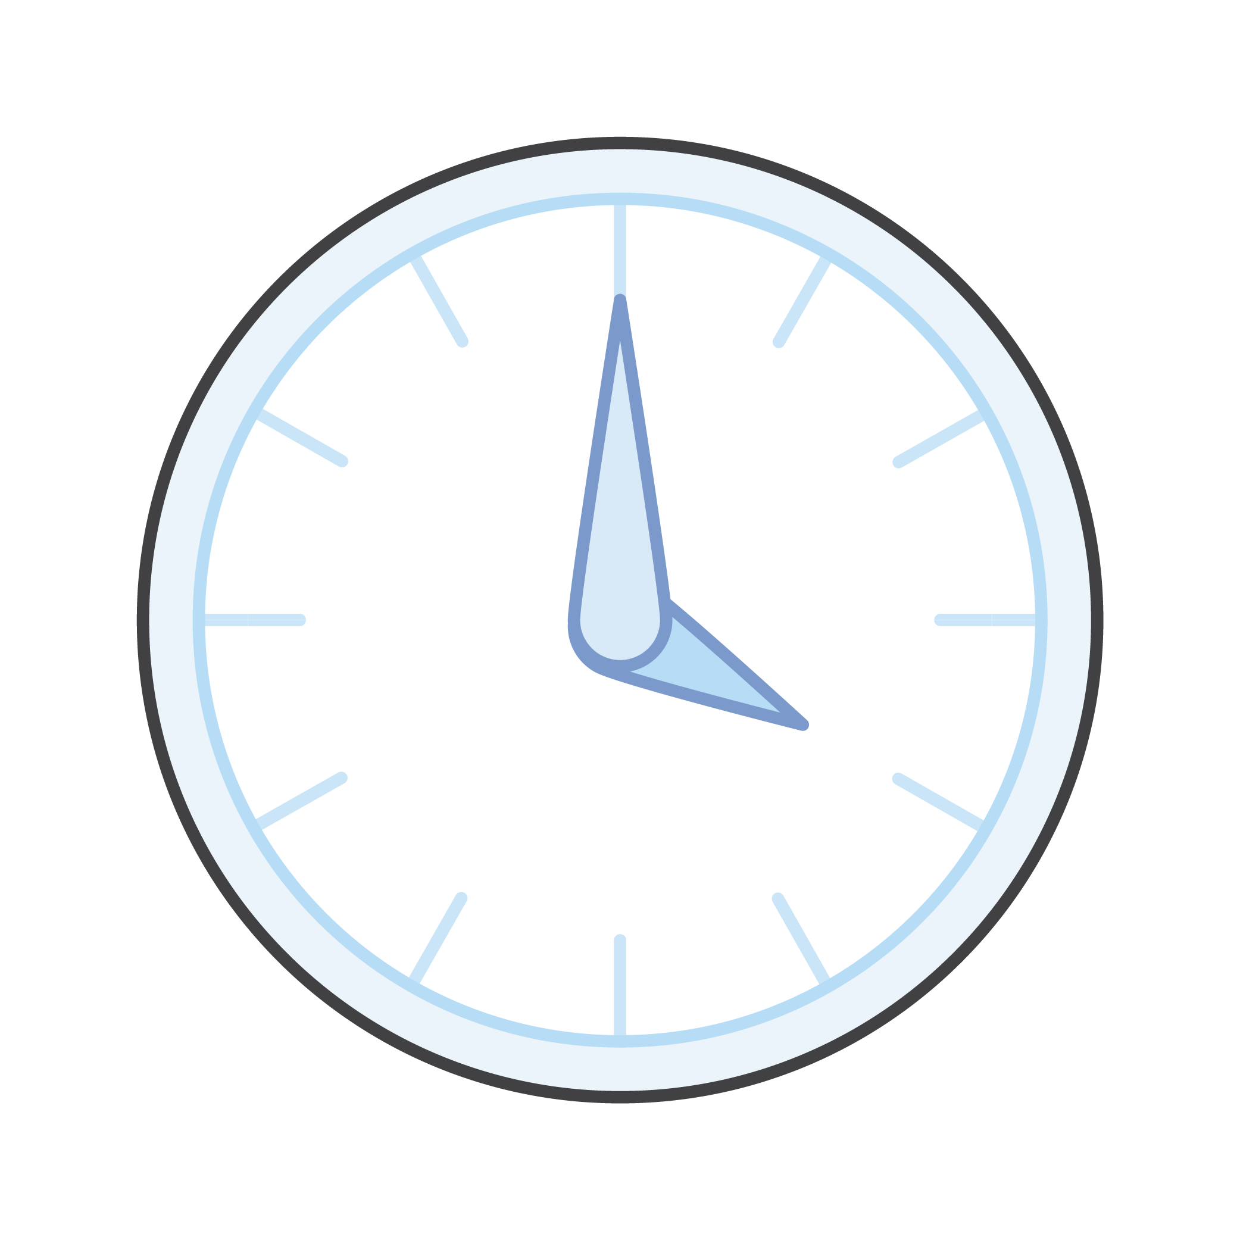
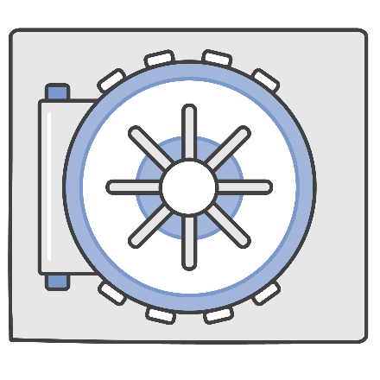

What's required for source control in the cloud?
Fully managed
High availability
Security
Store
anything
Notes:
- when you set up a cloud-based continuous delivery pipeline, you should consider hosting your source control in the cloud as well
- this will cut down on your management overhead, and place your source repositories close to your build, test, and production environments
- but if you do put your source code in the cloud, you're going to have some important requirements
- first, your source control system has to be highly available, because you need to be ready to deploy at any time
- you don't want a critical hotfix to be delayed just because your source control system is getting bogged down
- second, you'll want to take advantage of cloud scale so you're not held back from artificial limits
- you should be able to store whatever assets you want to version with your app, and you shouldn't have limits to your repo size
- third, you need robust security, because your source code is a valuable corporate asset

Slide 38
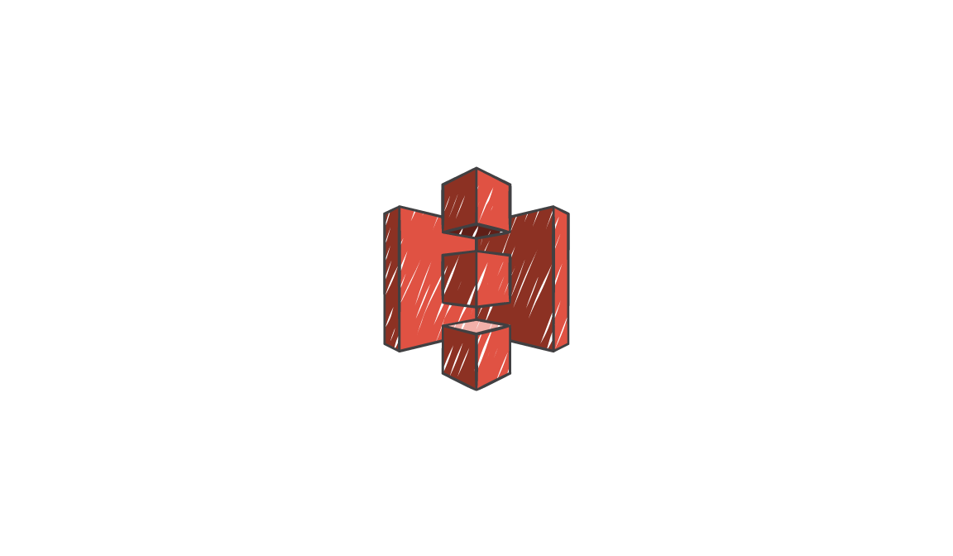

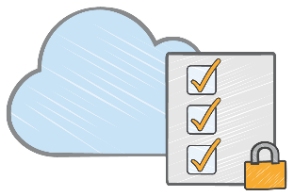
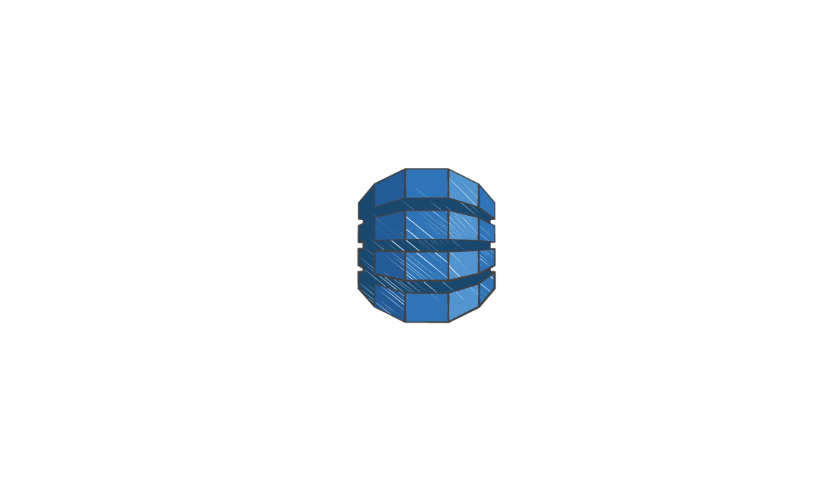

CodeCommit
Git objects
in Amazon S3
Secure, scalable, and managed Git source control
Git index
in Amazon
DynamoDB
SSH or HTTPS
git push
CodeCommit
Encryption key
in AWS KMS
Data redundancy across Availability Zones
Data-at-rest encryption
Integrated with AWS Identity and Access Management
No repo size limit
Notes:
- CodeCommit is Git source control service built on a cloud-scale architecture
- on the front-end, we're just a standard Git remote that you can push to and pull from using the Git CLI or other Git GUI tools
- but behind that Git endpoint is a novel implementation
- rather than use a file system-based implementation, we store the repo data in Amazon S3 and the index in Amazon DynamoDB
- this gives us a number of advantages
- the repo data is automatically stored across multiple availability zones
- this gives us enhanced data durability and service availability
- we also encrypt the data at rest using customer-specific encryption keys that are stored in our Key Management Service
- we use AWS IAM for access management, so you can assign permissions to your repos in the same way you assign permissions to your other AWS resources
- finally, we place no size limits on your repos
- CodeCommit provides a secure, scalable, and reliable Git service to front your continuous delivery pipelines

Slide 39
Same Git experience
$ git clone https://git-codecommit.us-east-1.amazonaws.com/v1/repos/aws-cli
Cloning into 'aws-cli'...
Receiving objects: 100% (16032/16032), 5.55 MiB | 1.25 MiB/s, done.
Resolving deltas: 100% (9900/9900), done.
Checking connectivity... done.
$ nano README.rst
$ git commit -am 'updated README'
[master 4fa0318] updated README
1 file changed, 1 insertion(+)
$ git push
Counting objects: 3, done.
Delta compression using up to 4 threads.
Compressing objects: 100% (3/3), done.
Writing objects: 100% (3/3), 297 bytes | 0 bytes/s, done.
Total 3 (delta 2), reused 0 (delta 0)
remote:
To https://git-codecommit.us-east-1.amazonaws.com/v1/repos/aws-cli
4dacd6d..4fa0318 master -> master

Slide 40
Summary
©2015, Amazon Web Services, Inc. or its affiliates. All rights reserved

Slide 41

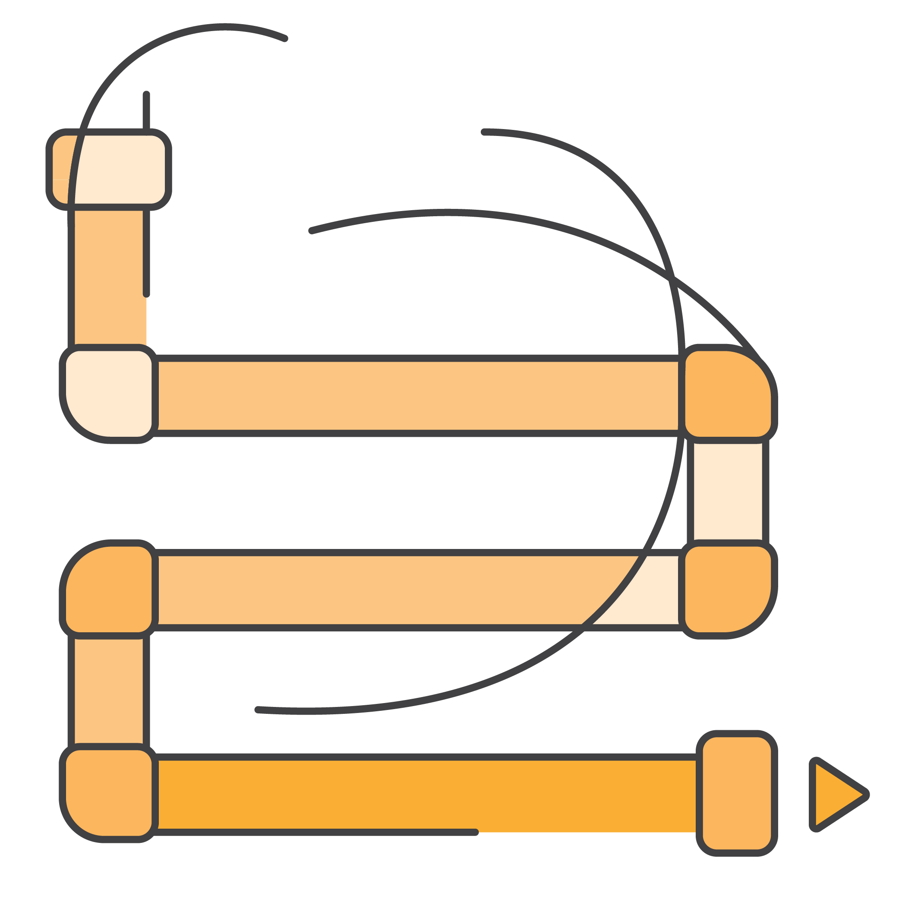
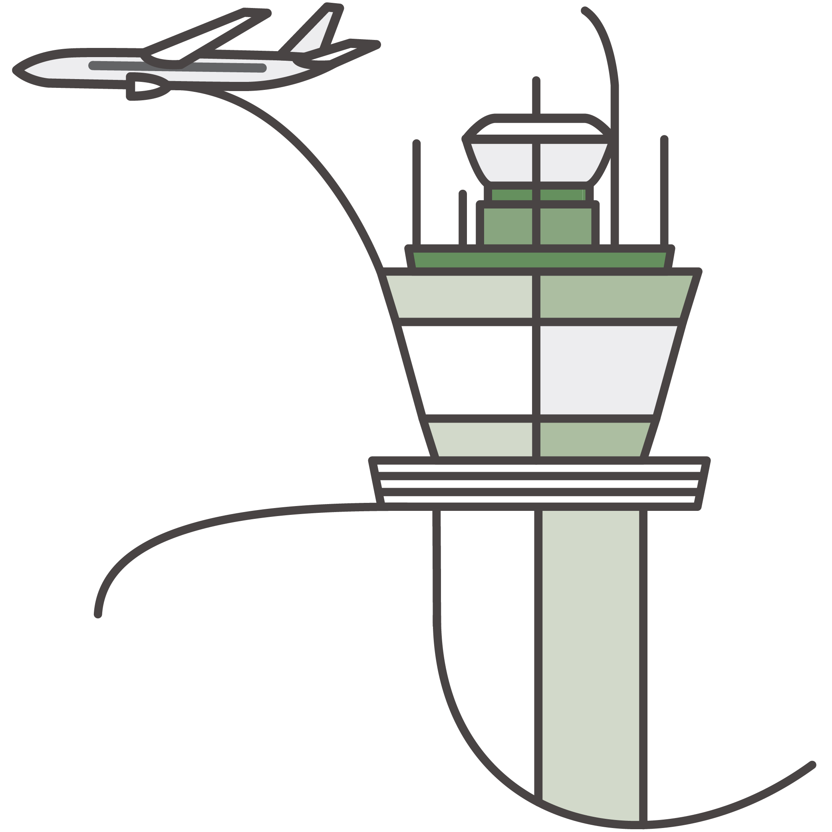

AWS code services
CodeCommit
CodePipeline
CodeDeploy
Notes:
- CodeDeploy launched last year and is available to all
- we will aggressively expanding to additional regions
- CodeCommit and CodePipeline will be coming soon
- register on the website if you're interested in private beta access, and we'll try to get you into one of the pre-launch waves

